Slide 1
Arabic Toxic Tweet Classification: Leveraging the AraBERT Model

Slide 2
Presented by
Jannatus Sakira Khondaker
Id - 2030148
Team no - 26
RA - Sania Azhmee Bhuiyan
ST - Farah Binta Haque

Slide 3
About this Presentation
Social media platforms have emerged as the principal channels for information sharing and communication, enabling users to engage in interactive conversations. Regretfully, hate speech and insults are among the offensive and harmful content that is shared on these platforms.
With the help of three linguists and native Arabic speakers, Google's Perspective API is automatically used to annotate the dataset.

Slide 4
Table of Contents
1
2
Summary
Limitations
3
Synthesis

Slide 5
SUMMARY

Slide 6


Motivation
This work sheds light on the significance of addressing toxicity in social media platforms while taking into account diverse languages and cultures, and it represents a significant advancement in the classification of toxic
tweets in Arabic.

Slide 7
Contributions
They construct a novel dataset of 31,836 Arabic tweets, annotated as toxic or non-toxic using Google’s Perspective API and the expertise of three native Arabic speakers and linguists.
They conduct a series of experiments using seven models: LSTM, BiLSTM, CNN, GRU, BiGRU, mBERT, and AraBERT. They also employ word embedding techniques such as AraBERT and mBERT.
They demonstrate that the fine-tuned AraBERT model outperforms other models, achieving an accuracy of 0.9960. They also show that their accuracy value surpasses similar approaches reported in recent literature
They advance the field of Arabic toxic tweet classification, highlighting the importance of addressing toxicity in social media platforms while considering diverse languages and cultures.

Slide 8
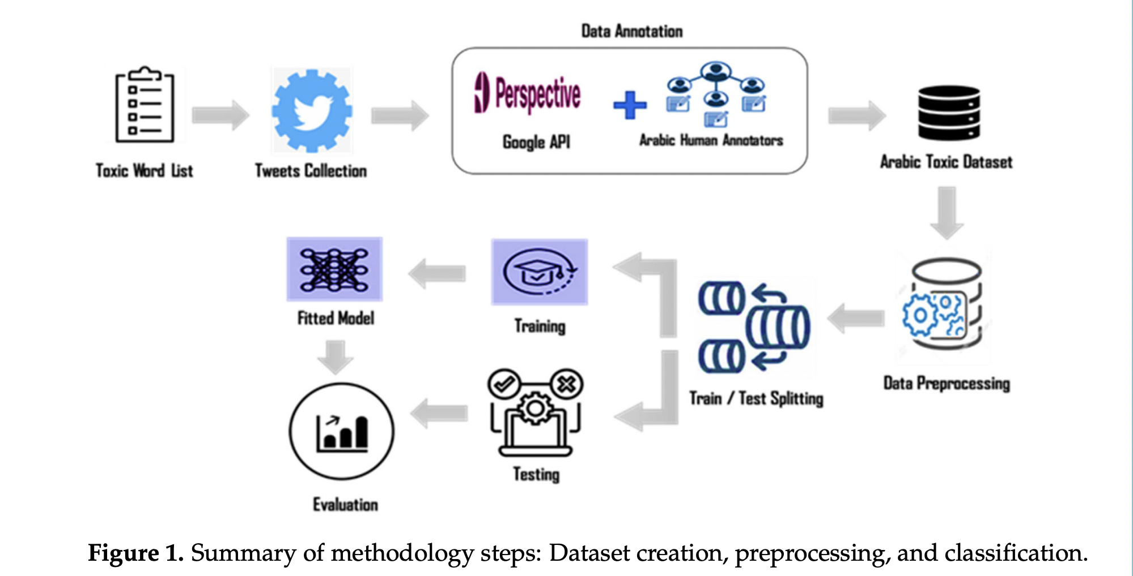
Methodology
Data Set Creation
Preprocessing
Classification

Slide 9
Conclusion
The authors conclude that their proposed dataset is a valuable resource for Arabic toxic tweet classification, and that their fine-tuned AraBERT model is the most effective in identifying toxic content in Arabic tweets.

Slide 10
Limitations
First Limitation
Second Limitation
Dataset Size & Diversity
Model Generalization and
Interpretability
The authors acknowledge that their dataset is relatively small compared to other datasets for toxic content analysis in English.
The authors admit that their fine-tuned AraBERT model may not generalize well to other domains and tasks, as it is tailored to their specific dataset and task.

Slide 11
Synthesis
The paper provides a valuable resource for researchers and practitioners interested in studying and combating toxic content in Arabic social media platforms, as it offers a standardized and publicly accessible dataset and a comprehensive evaluation of different models and techniques.
The paper contributes to the advancement of Arabic NLP, as it demonstrates the superiority of the AraBERT model, which is a pre-trained language model specifically designed for Arabic texts and dialects, over other multilingual and monolingual models.
The paper opens up new avenues for further research and development in the field of toxic content detection and prevention, as it suggests possible ways to improve the quality and diversity of the dataset, the generalization and transferability of the models, and the incorporation of other factors and features, such as context, intent, and sarcasm, into the classification task.

Slide 12
Thank you!

